Slide 1
Servlets Overview

Slide 2

Agenda
Introduction to Java Servlets
Servlet Life Cycle
Describe web applications, CGI, and the role of Java
Describe benefits of Java servlet technology
Create a simple Java Servlet

Slide 3
Introduction to Java Servlets
Read explicit data sent by client (form data)
Read implicit data sent by client (request headers)
Generate the results
Send the explicit data back to client (HTML)
Send the implicit data to client (status codes and response headers)

Slide 4
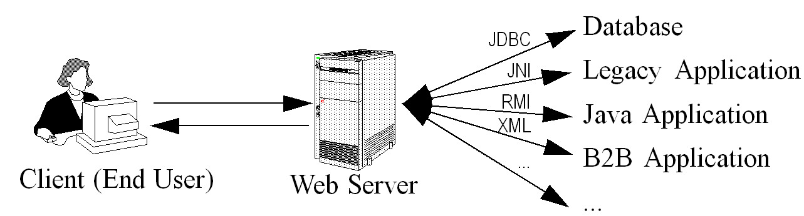
Servlets Overview(cont.)

Slide 5
Servlets LifeCycle
A servlet passes through the following stages in its life.
Initialize
Service
Destroy

Slide 6
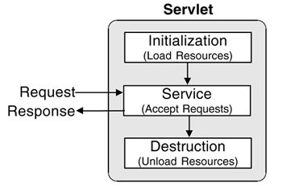
Servlet’s Life Cycle (Cont)

Slide 7
Characteristic of Init() stage
Executed once, when the servlet gets loaded for the first time
Not called for each client request
The above two points make it an ideal place to perform the startup tasks which are done in constructor in a normal class.

Slide 8
Characteristic of service() stage
service() method is the engine of the servlet
It is executed per request in a separate Thread
Hence faster and efficient than CGI
It is an important method to be overridden in GenericServlet

Slide 9
Benefits of Servlets
Efficient
Servlets are light weight java threads and not a process like CGI
For each request there would be a n no of threads for n
no of requests but only a single Object of a Servlet class
When CGI finishes handling request the program terminates making difficult to cache computations ,keep connection open etc
Servlets remain in the memory even after the response is complete.

Slide 10
Benefits of Servlets
Convenient
Servlets have an extensive infrastructure for
Parsing and decoding
Reading and setting http headers
Handling cookies
Tracking sessions
In CGI we have to depend on Perl for such tasks

Slide 11
Benefits of Servlets
Powerful
Servlets support several capabilities like
Communicating with Web Server
Translate relative URL’s to concrete Path
Sharing data
Connection Pooling and optimization
In CGI we have to user server specific API

Slide 12
Benefits of Servlets
Portability
Servlets are written in java and can be deployed in Multiple Servers
Secure
Being written entirely in java.
Does not rely on O/S shell as CGI

Slide 13

Summary
Demonstrate a simple Servlet example
Overview the Life cycle of a servlet
Benefits of Servlet compared to CGI

